Slide 1
Session 13
Data structures
using C++

Slide 2
Session objectives
Differentiate between pointers and references
Discuss linked lists
Operate with stacks
Define queues

Slide 3
Introduction to references (1)
An alternative name used for a previously defined
variable is known as reference
int sum;
int &add = sum ; //makes add as an alias for sum
Changes made in the variable are reflected
in the reference and vice -versa

Slide 4
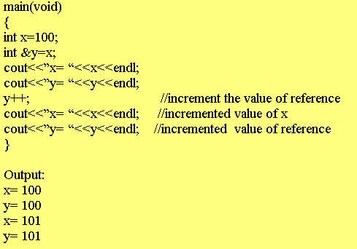
Introduction to references (2)
The symbol ‘& ‘ is used as a part of the type identifier

Slide 5
Pointers and References
Unlike pointers null references cannot be defined
Restrictions on references
    ➢ A reference cannot be used for a reference variable
➢ An array of references cannot be defined
➢ A pointer to reference cannot be created

Slide 6
Data structure
Collection of data elements whose organization
is characterized by the functions accessing them
Built in data structures
- accessing is transparent to the user
User defined data structures
- user defines functions to access them

Slide 7
Stacks
Works on the principle of Last In First Out
LIFO
Elements are added or deleted from one end

Slide 8
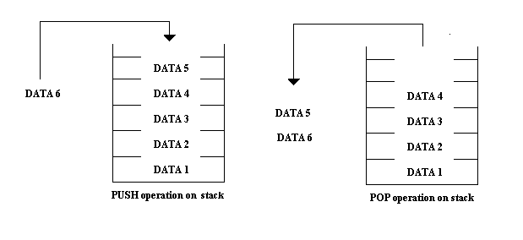
Operation on Stacks
Adding elements
Removing elements

Slide 9
Implementing Stacks using arrays
Stacks can be implemented using arrays or linked list
If implemented using arrays
a subscript is used to access the top element
The subscript increases or decreases
as elements are added or removed

Slide 10
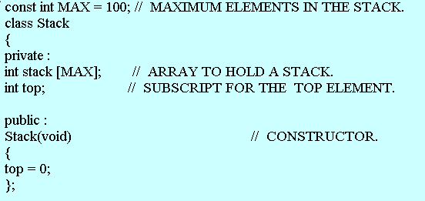
A class for stacks (1)

Slide 11
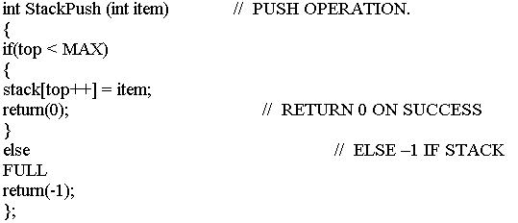
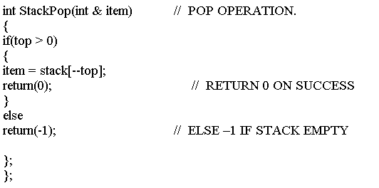
A class for stacks (2)

Slide 12
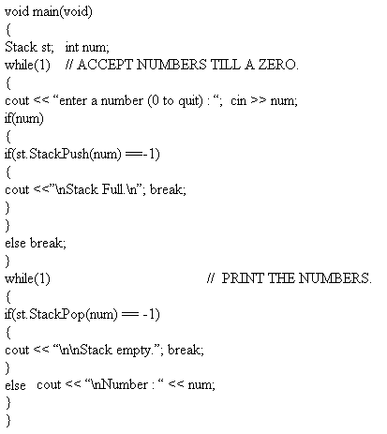
A program for stack

Slide 13
Applications of stacks
Arguments are passed between functions using stack
Address of the calling function is stored onto stack
Applications where back tracking is required
Evaluation of mathematical expressions

Slide 14
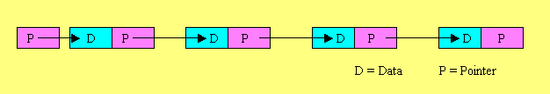
Linked List
A linked list is a collection of elements,
also called nodes, each containing the data
item to be stored and a pointer ( or link )
to the next node
A linked list always starts with a pointer to the first element

Slide 15
Operations on Linked List
Linked lists have to be
Created and nodes to be added
Operated upon ( traversing the list )
Disposed ( nodes to be deleted )

Slide 16
Defining a class for linked list
struct Node // REPRESENTS A NODE.
{
char *string; // INFORMATION FIELD.
Node * next; // POINTER TO NEXT NODE.
};
class List // MODELS A LINKED LIST.
{
private :
Node *head; // POINTER TO THE FIRST NODE
public :
List (); // CONSTRUCTOR.
int ListInsert(char *str);
int ListDelete(char *str);
void ListPrint(void);
};

Slide 17
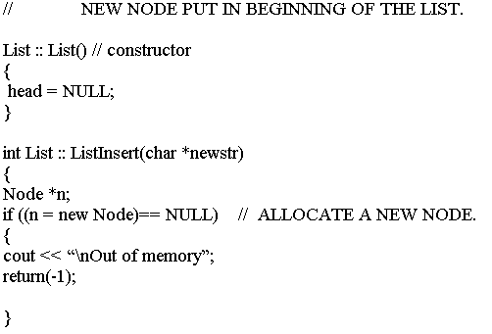
Creating a linked list (1)

Slide 18
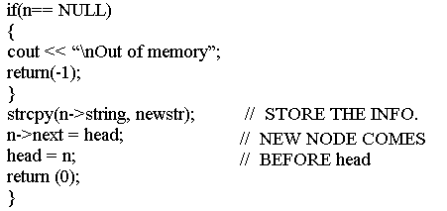
Creating a linked list (2)

Slide 19
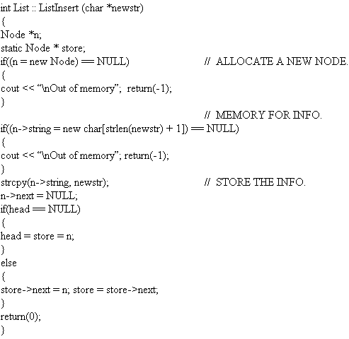
Adding a Node

Slide 20
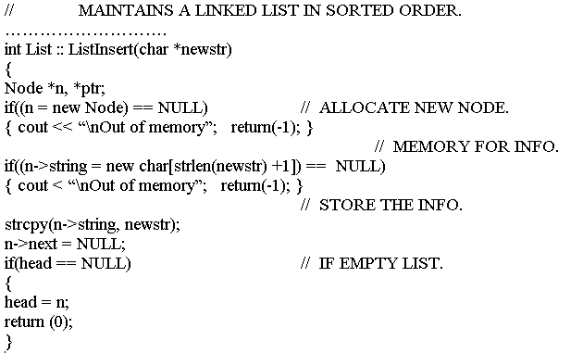
Linked List sorting (1)

Slide 21
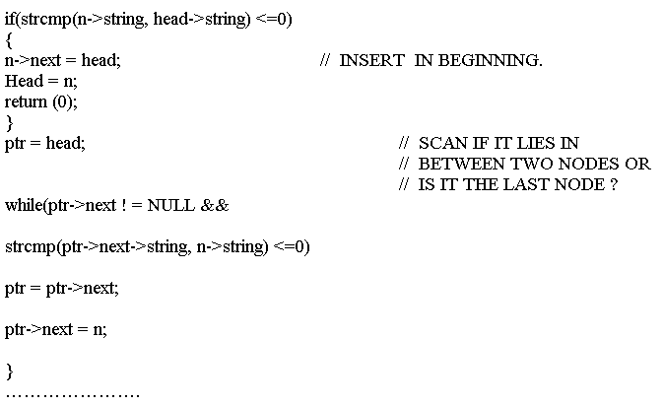
Linked List sorting (2)

Slide 22
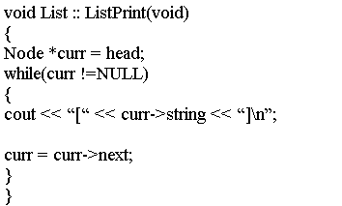
Printing a Linked List

Slide 23
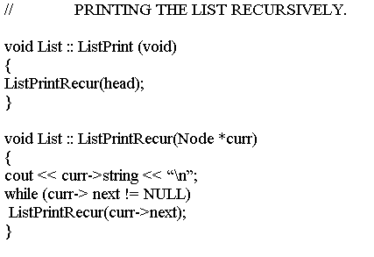
Printing a Linked List recursively

Slide 24
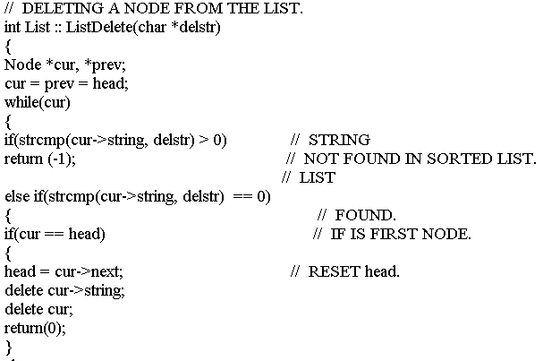
Deleting a Node (1)

Slide 25
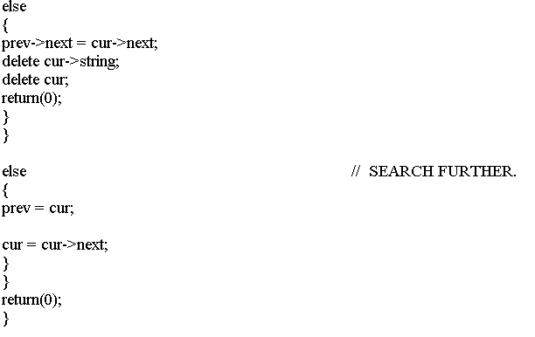
Deleting a Node (2)

Slide 26
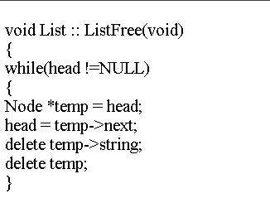
Freeing the Linked List

Slide 27
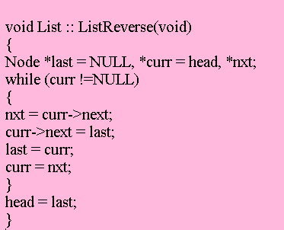
Reversing a Linked List

Slide 28
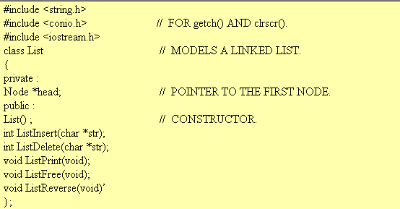
A Linked List program (1)

Slide 29
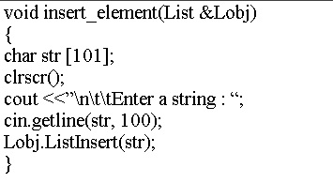
A Linked List program (2)

Slide 30
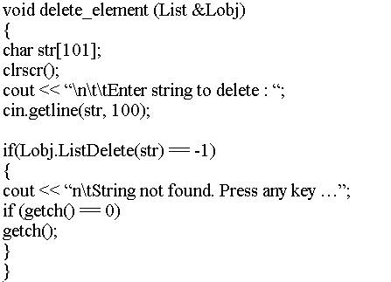
A Linked List program (3)

Slide 31
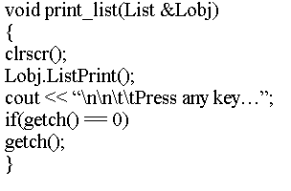
A Linked List program (4)

Slide 32
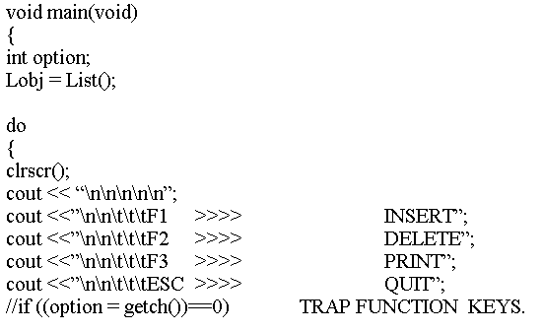
A Linked List program (5)

Slide 33
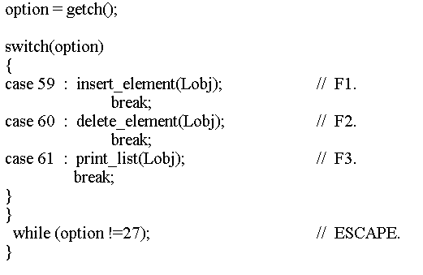
A Linked List program (6)

Slide 34
Doubly Linked List
P1
Null
Data
P2
P1
Data
P2
P1 and P2 are different
pointers for each node
P1
Data
P2
P1
Data
P2
Null

Slide 35
Circular Linked List
Data
P
Data
P
Data
P
P
Data
Data
P
P
P
Data
P
Data
Data

Slide 36
Advantages and Disadvantages
Dynamic storage
Advantages
Compared to an array
insertions and deletions
are easily done
Disadvantages
Huge memory occupied
by pointers
Random access
not possible

Slide 37
Stacks using Linked Lists
If arrays are used
stack memory becomes static and limited
Arrays cannot grow dynamically
Memory locations reserved when defined

Slide 38
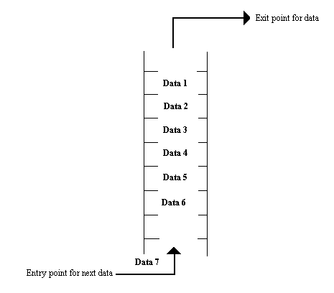
Queues
A queue is a list in which all additions are made at one end and all deletions are made from the other end
FIFO
( First In First Out )

Slide 39
Operations on Queue
Creating a queue
Initializing a queue
Adding an element
Deleting an element
First item on queue = Head
Last item on queue = Tail

Slide 40
Queue using an Array (1)
Points to be considered :
Maintain two subscripts,
one for the head and one for the tail
Keep the head of the queue in the
0th position
An item can be added by increasing
the subscript and adding the element
4. Delete an element from from the front end.
Move the rest of the elements up by one position

Slide 41
Queue using Linked List
Two pointers are required
- one for the head
- the other for the tail
Since memory will be dynamically allocated,
problems in implementing queues using arrays
can be eliminated

Slide 42
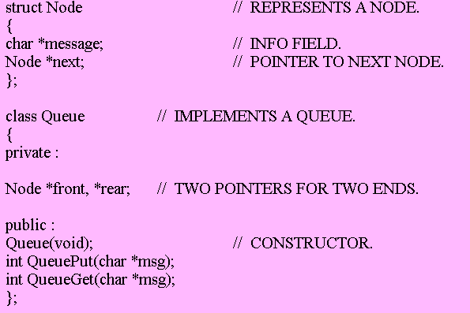
Defining a Class for queue

Slide 43
Queue methods (1)
Constructor
Queue :: Queue(void)
{
front = rear = NULL;
};

Slide 44
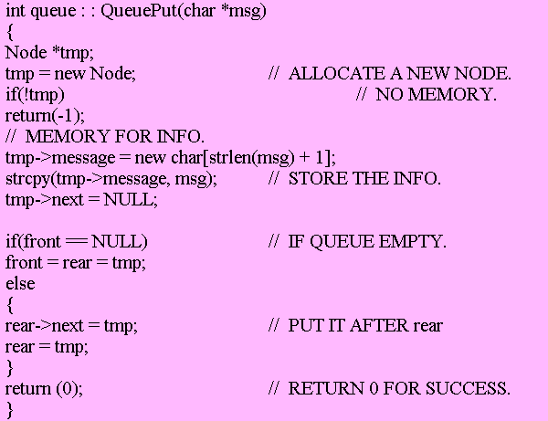
Queue methods (2)
QueuePut

Slide 45
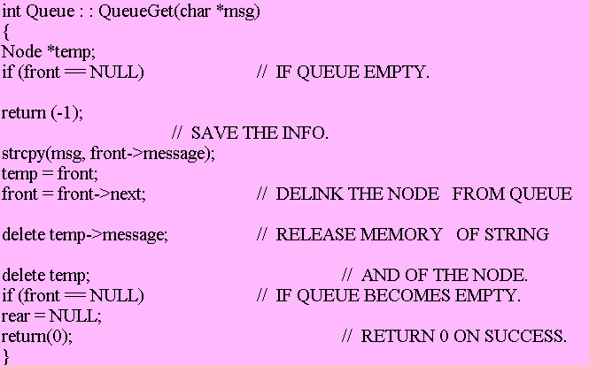
Queue methods (3)
QueueGet

Slide 46
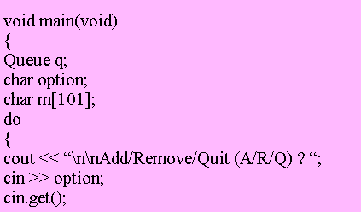
Using a Queue (1)

Slide 47
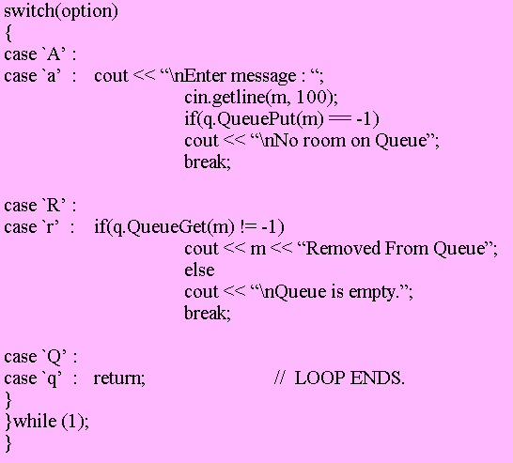
Using a Queue (2)

Slide 48
Applications of Queues
Computer processes
UNIX O/S uses queues for
almost all of its operations
Interrupt processing in DOS or
a type ahead keyboard buffer
Simulation using computers

